Slide 1


BOSE PROFESSIONAL
2022 MEDIA STRATEGY
Josh Brummett
VP of Media Production, MarketScale

Slide 2

Bose Professional 2022 Goals
Product Focused
  VB1 Video Conferencing Device Product Release – Q2
  DesignMax Background Audio
  L1 Portable Speaker
Company Identity
  World Class Audio Engineers
  Improve credibility
Industry Vertical Growth
  Growth in Hospitality
  Growth in Places of Worship

Slide 3
VB1 Product Release
Live Event
  VB1 Media Press Event where we demo the VB1 live to a private press event. We mix in pre-recorded 3D content to show how the VB1 works, pre-recorded interviews with the engineers behind the technology, and a live demo on the product and program with Q&A at the end. We reveal at the end that the live demo was shot on VB1.
Media
  Product Photography of VB1 – Capture photography of the VB1 in use for marketing materials
    School Classrooms
    Corporate Conference Rooms – Professional and Casual
    Hospitality rooms
  3D Video showcasing the video technology, microphone pick-up array, and how the speakers are able to fill a medium size room. The technology is hard to visualize with video cameras, a mix of 3D and motion graphics will allow the users to see how the VB1 functions.
Podcast
  In the post-covid world, remote interviews and calls are the standard. VB1 allows users from all over the world to stay connected. The next Bose Professional Series will be called “Better Connected” and it will be shot entirely on the VB1. Hosted by Bose, we will feature people from around the world who are helping connect and educate our society, and how changes in social media, government, technology, education, etc. are adapting to technology.

Slide 4
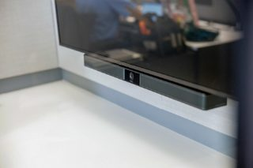
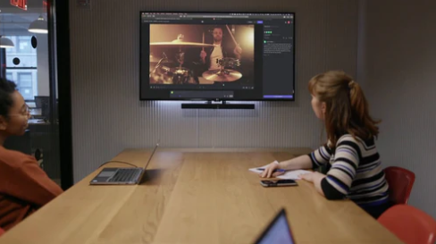
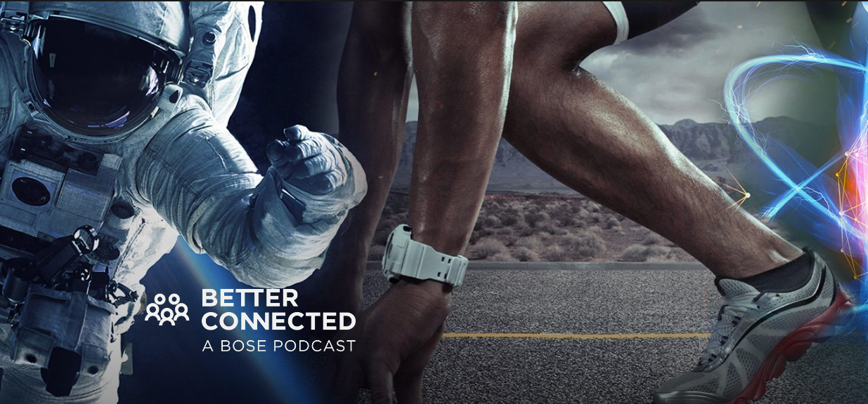
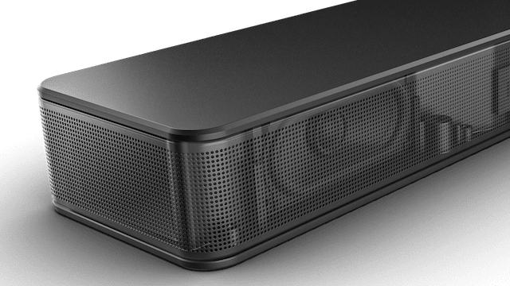

Slide 5
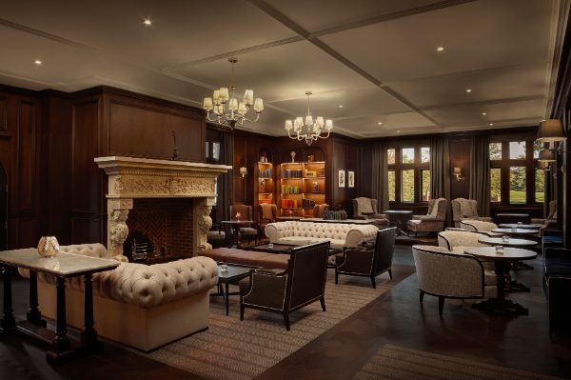
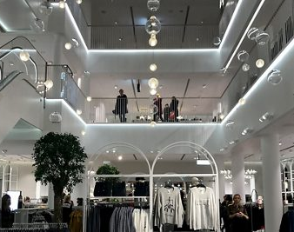
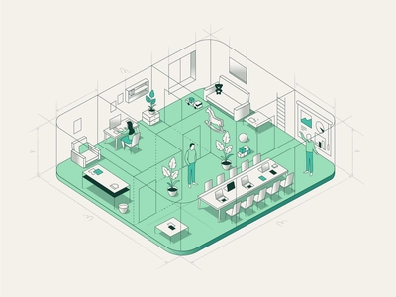
DesignMax
Media
  Case Study Video featuring the use of the DesignMax at the prestigious Fairmont Windsor Park in London. This will also help grow the hospitality vertical market.
  Case Study Video from a retail environment.
  Photography at each location to help further promote on Social and Website
Infographics
  Floor plan layout in an isometric view showing how the Bose Speaker maintains even coverage and blends into the architecture.
Written Blogs
  We will produce written case studies from the following video products but add notes from the onsite engineer from Bose to show how they were able to achieve great results.

Slide 6
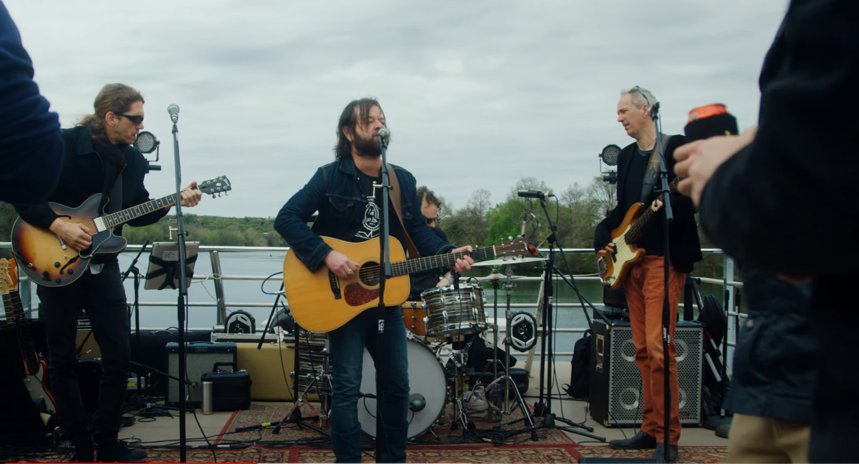
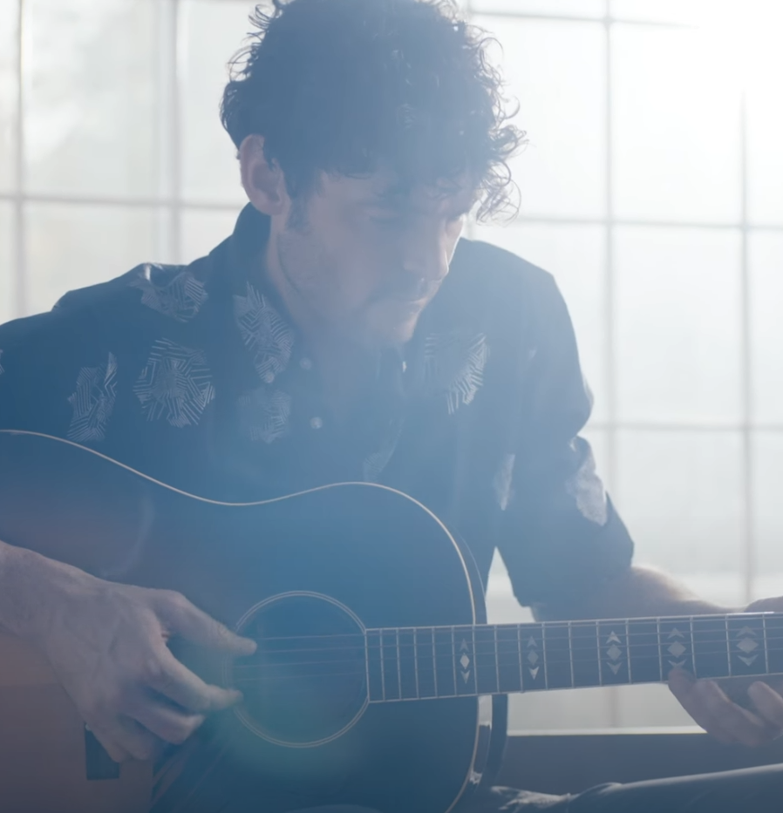
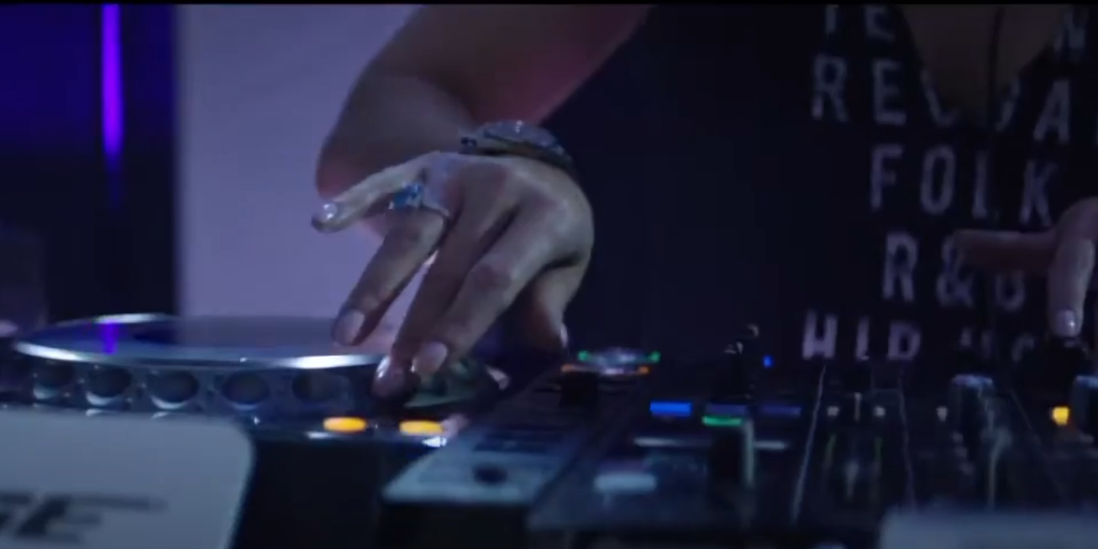
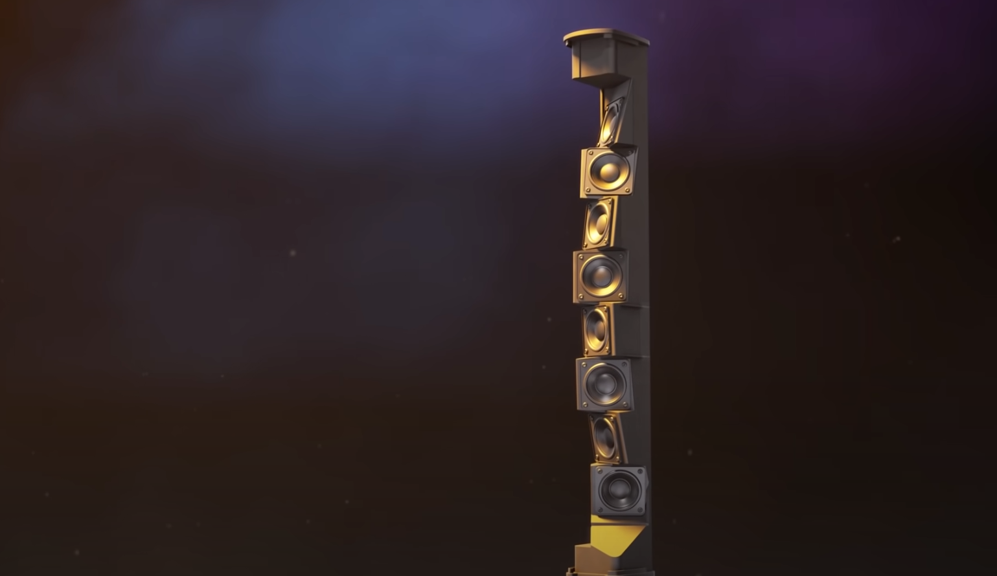
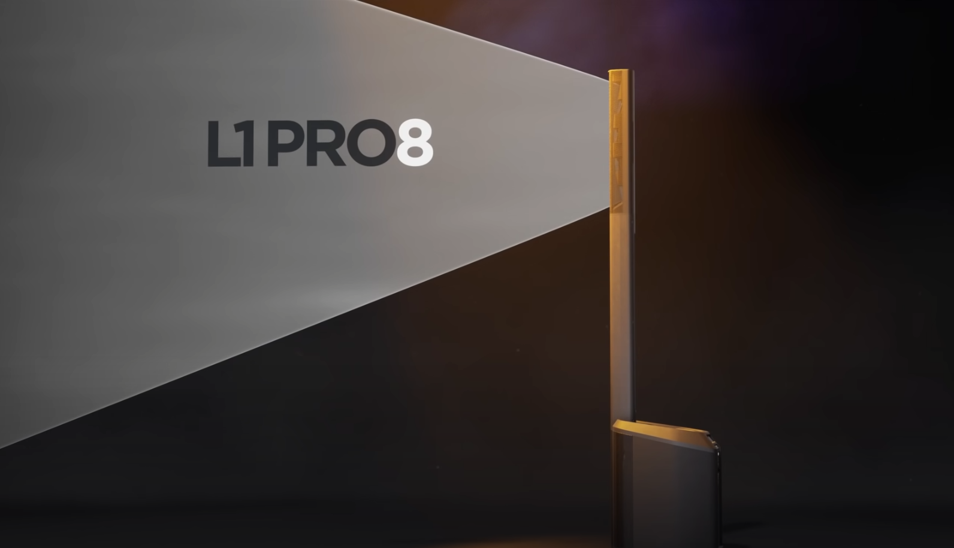
L1 Portable Speaker
Media
  Behind the Music Spotlight Series- Taking some inspiration from “Behind the Mac” series, we will follow various DJs and Musicians and capture the work that goes into their music and lead it up until they go on stage. We talk about the importance and moving the crowd and we show glimpses of the LB1 product helping bring emotion to the stage.
  Photography captured at each shoot will allow Bose to post multiple social media posts tagging the artist, allowing the artist and Bose to grow their interaction.
  Portability Commercial – 30 second spot all centered frame angled cutting to various venues, indoor and outdoor, showing that the L1 can we set up and ready in as little as 30 seconds.
  3D Video – The technology behind the L1 is very interesting and audio techs will want to see how the various product line ups will be able to beam sound to the audience. We will show the various speaker arrays and how they function behind the grill.
Infographics
  Using 3D visuals from the video we will create infographics that show how the sound travels in a given venue space, and how the Bose arrays can be adjusted depending on the room size.

Slide 7
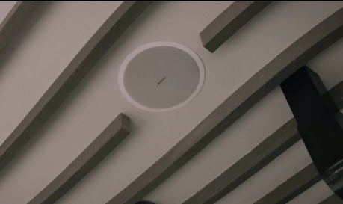
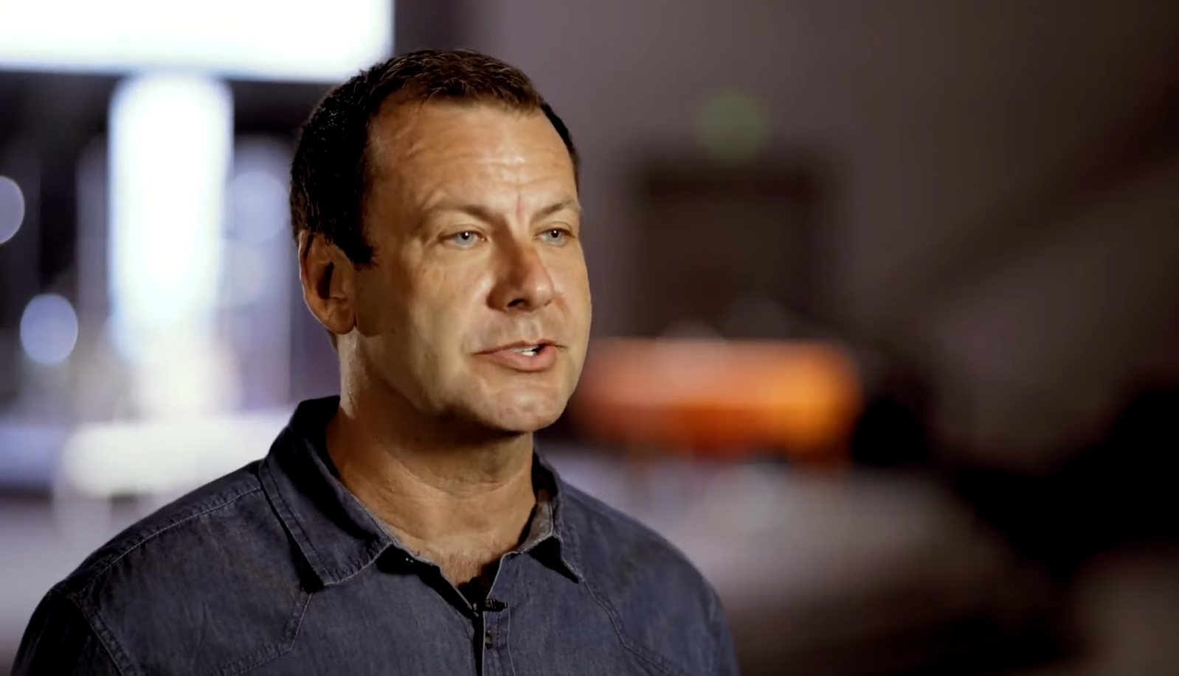
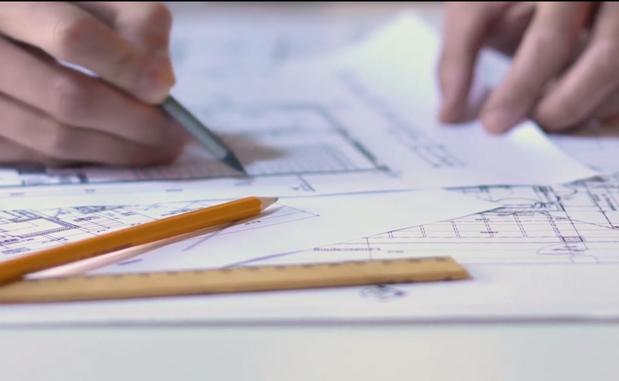
Company Identity
  Media - Employee Spotlight Videos – Engineers
    We will showcase Bose’s world-class engineers and get a personal look at why they got into audio engineering, how they are able to develop the technology to produce great results, and then the testing that goes into it. For the engineers it is a labor of love and showing how happy they are with the sound will show people that Bose prides itself on being the best.
  Media - A collection of testimonials and already discussed case studies will help bring credibility to the Bose name, showing many happy customers and measuring the success of the facilities. This will allow viewers comfort in picking the premium Bose brand.

Slide 8
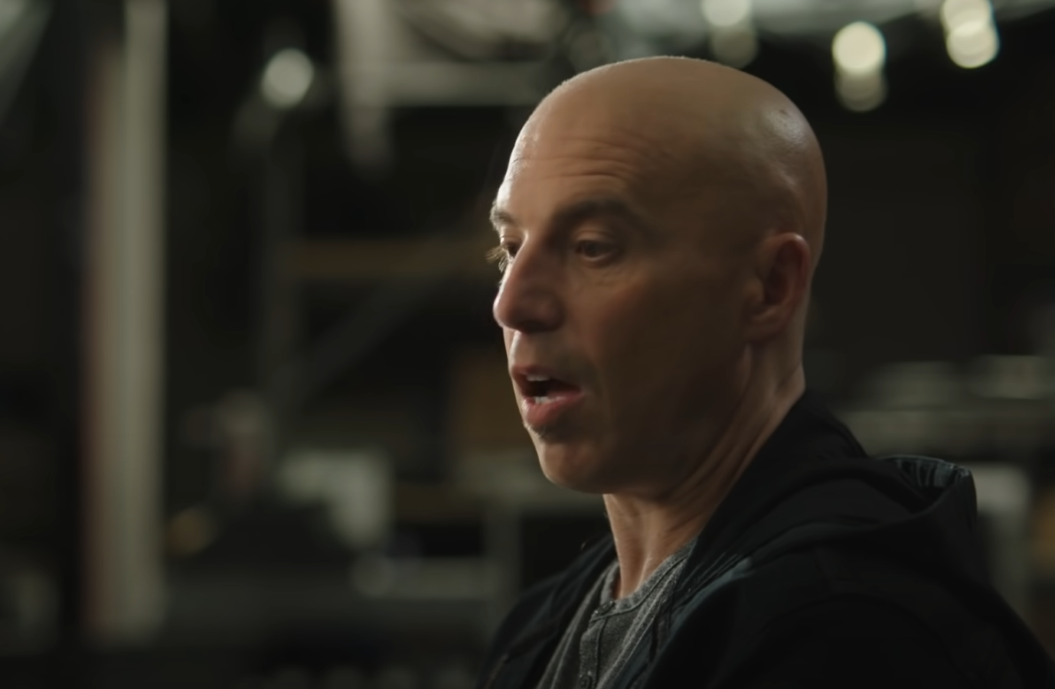
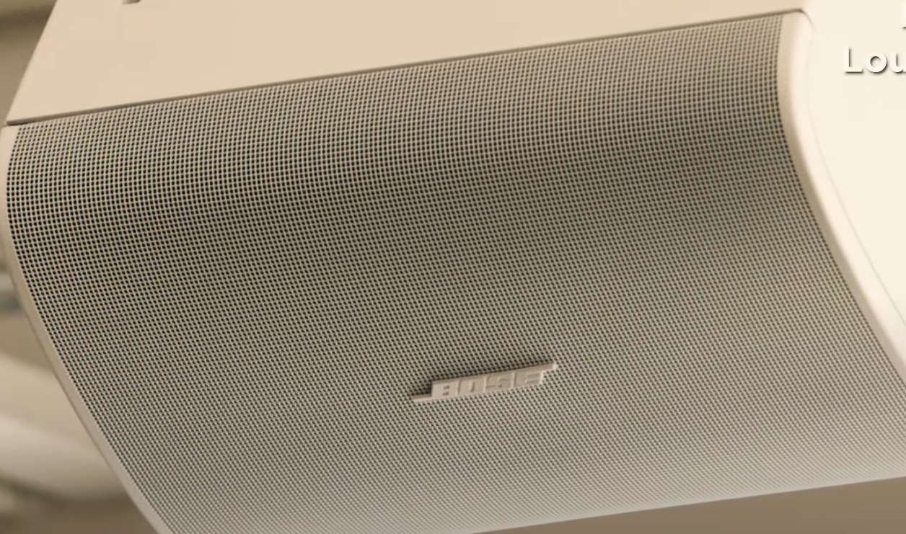
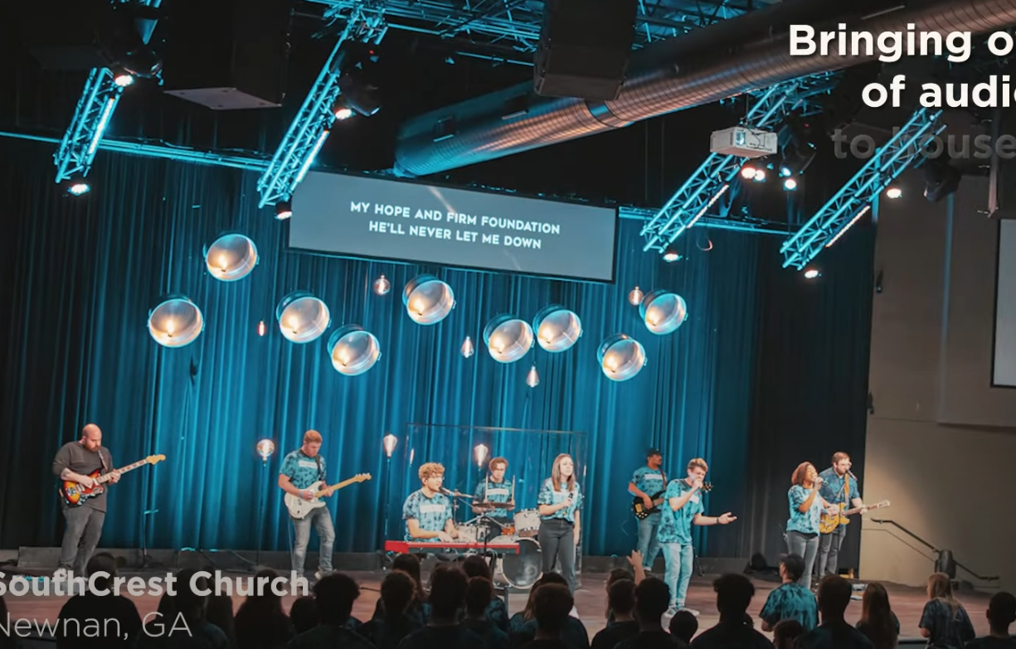
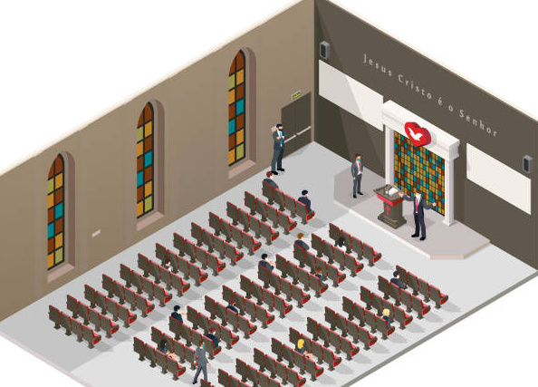
Industry Verticals
Hospitality
  Case study Video - Along with the Windsor Hotel Video, we will produce 1 more hospitality case study video to help tell the larger story and add credibility.
  Webinar Recordings – Pulling different Hospitality experts and Hotel owners into a 4-person webinar recording where the Bose host can talk about the importance of sound in the hospitality space. We will break up this content into bite size pieces.
  Info graphics used in DesignMax plans can be used to promote the Bose product in customer experience and design in the hotel space.
House of Worship
  The Sound of Worship Series – video series that focuses on various churches and how the power of worship drives the success of the church and the ability for guests to connect to God. Bose products give excellent sound quality, and that allows people to focus more on the music, and less about sound issues. Same during sermons. Every word can be heard with clarity.
  Motion Graphic Explainer – Churches are large spaces, and equipment is expensive. Church managers are going to want to know how efficient the Bose equipment is. Being able to map out various church spaces and sizes in 2D animation and showing how the speakers will output large areas in the church will show that they will need less equipment with greater clarity than the competitor.

